Slide 1
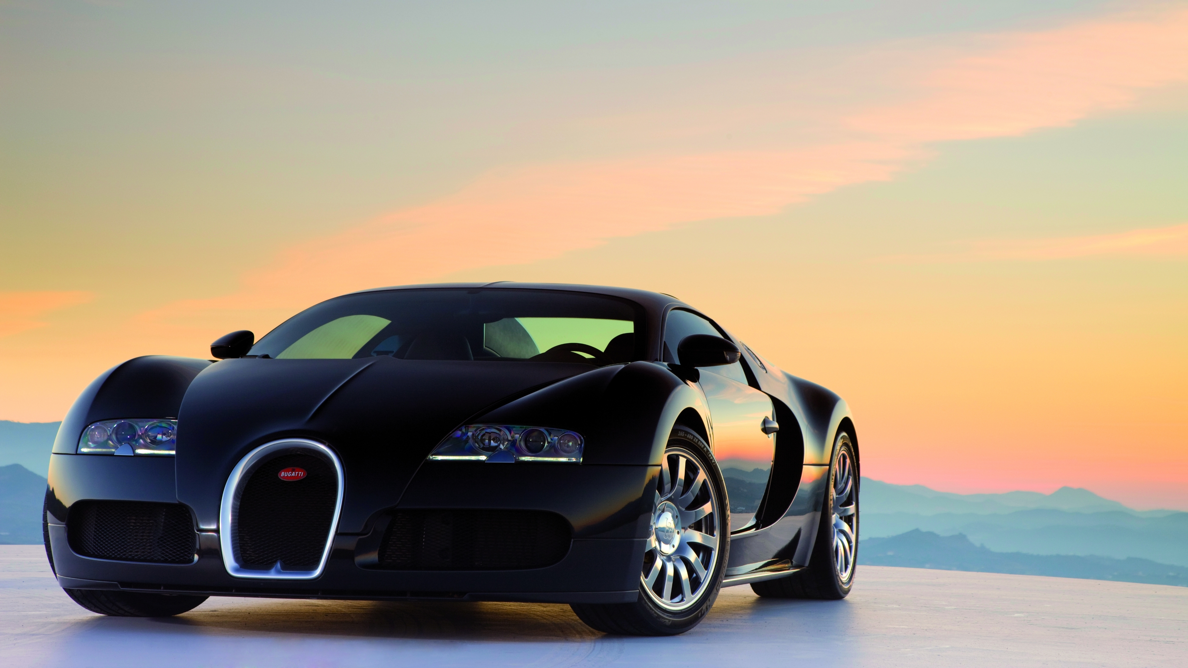
ANALYZING THE IMPACT OF CAR FEATURES ON PRICE AND PROFITABILITY
FINAL PROJECT -3
~ ARYAN AUDITTO

Slide 2

PROJECT DESCRIPTION :
This project aims to analyze a dataset titled "Car Features and MSRP" to gain insights into various aspects of the automotive industry. The purpose is to explore trends in car features and pricing, understand the relationship between car attributes and their popularity, identify the key factors influencing car prices, and examine how different manufacturers and market categories impact car prices. The dataset, containing information on over 11,000 car models, was collected and made available by Cooper Union on Kaggle. The data cleaning process involved identifying and addressing missing values, inconsistencies, and errors to ensure accurate analysis.
For this project, descriptive statistics, data visualization, regression analysis, and correlation analysis techniques were used. Descriptive statistics helped summarize and understand the distribution of variables, while data visualization techniques, such as pivot tables, combo charts, scatter charts, and bar charts, were employed to visually represent relationships and patterns in the data. Regression analysis was performed to identify the variables with the strongest relationship to car prices. The correlation analysis quantified the strength and direction of the relationship between fuel efficiency and the number of cylinders in a car's engine.
APPROACH :
TECH-STACK USED :
I used Microsoft Excel as the primary tool for data analysis and dashboard creation due to its versatility and ease of use for data manipulation, analysis, and visualization.

Slide 3

INSIGHT :
The popularity of car models varies across different market categories, with some categories having a significantly higher number of models and popularity scores compared to others.
There is a positive relationship between a car's engine power and its price, indicating that higher-powered engines tend to be associated with higher prices.
The variables that have the strongest relationship with a car's price are engine power, market category (luxury or performance), and vehicle size, as indicated by their coefficient values in the regression analysis.
Average car prices vary across different manufacturers, with some brands having significantly higher or lower average prices compared to others.
There is a negative relationship between the number of cylinders in a car's engine and its highway MPG, suggesting that cars with more cylinders tend to have lower fuel efficiency.
RESULTS :

Slide 4
CAR FEATURES DATASET
HYPERLINK FOR WORKING EXCEL FILE : Car_data_final
NOTE: All the tasks are shown in this working file and each task is separated into different sheets

Slide 5
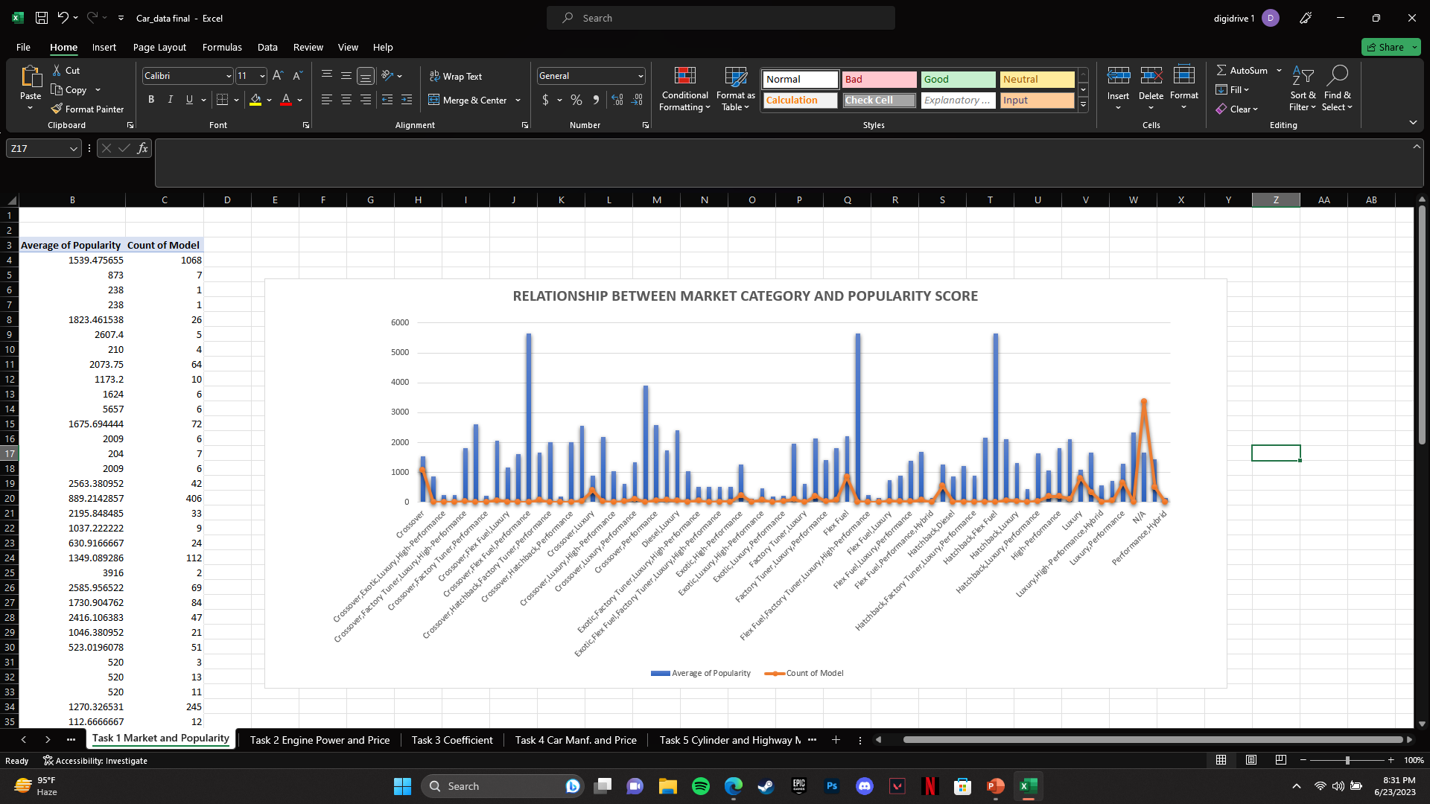
How does the popularity of a car model vary across different market categories?
Task 1.A: Create a pivot table that shows the number of car models in each market category and their corresponding popularity scores.
Task 1.B: Create a combo chart that visualizes the relationship between market category and popularity.

Slide 6
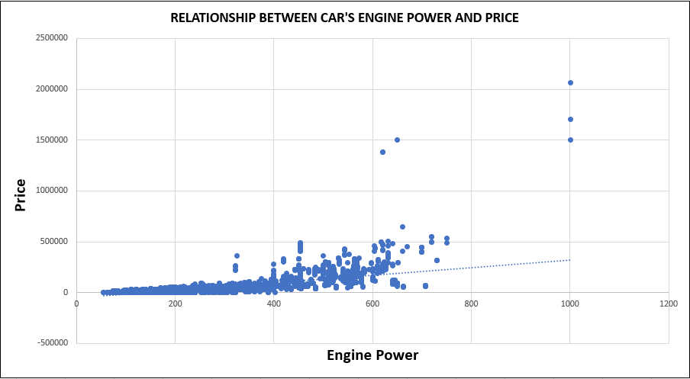
What is the relationship between a car's engine power and its price?
Task 2: Create a scatter chart that plots engine power on the x-axis and price on the y-axis. Add a trendline to the chart to visualize the relationship between these variables.

Slide 7
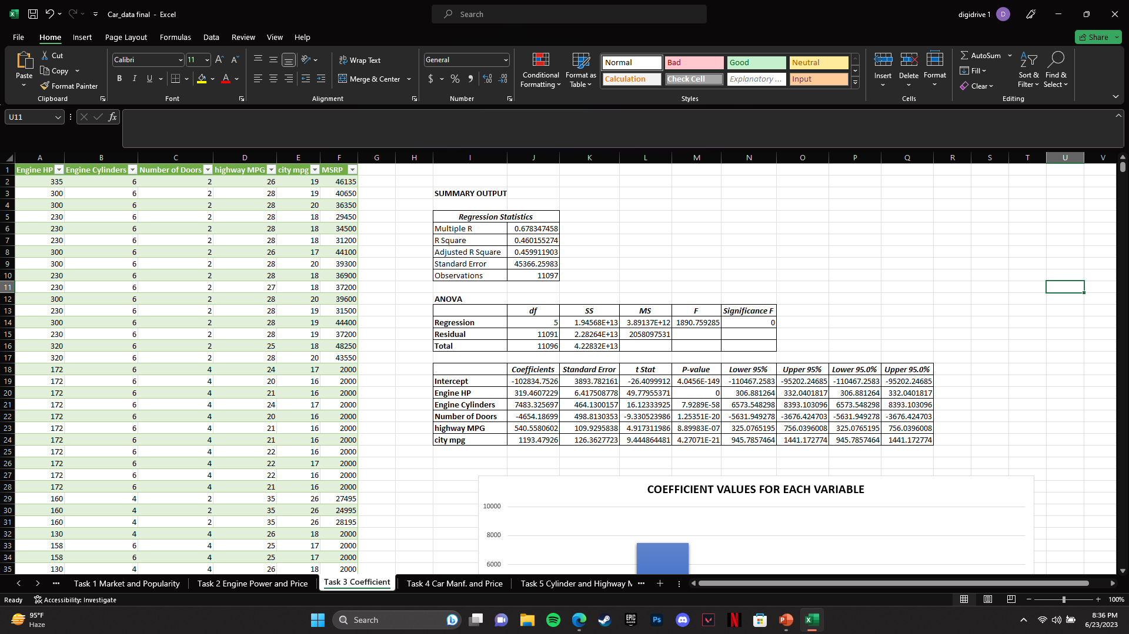
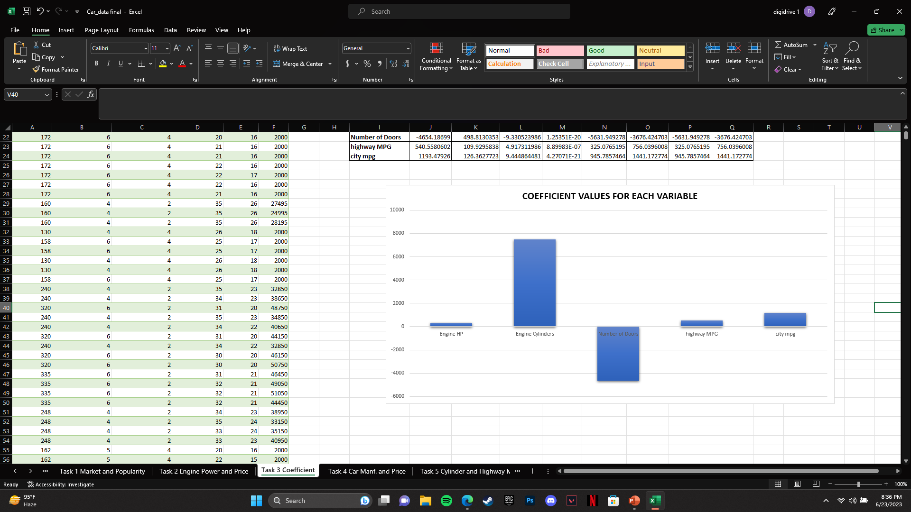
Which car features are most important in determining a car's price?
Task 3: Use regression analysis to identify the variables that have the strongest relationship with a car's price. Then create a bar chart that shows the coefficient values for each variable to visualize their relative importance.

Slide 8
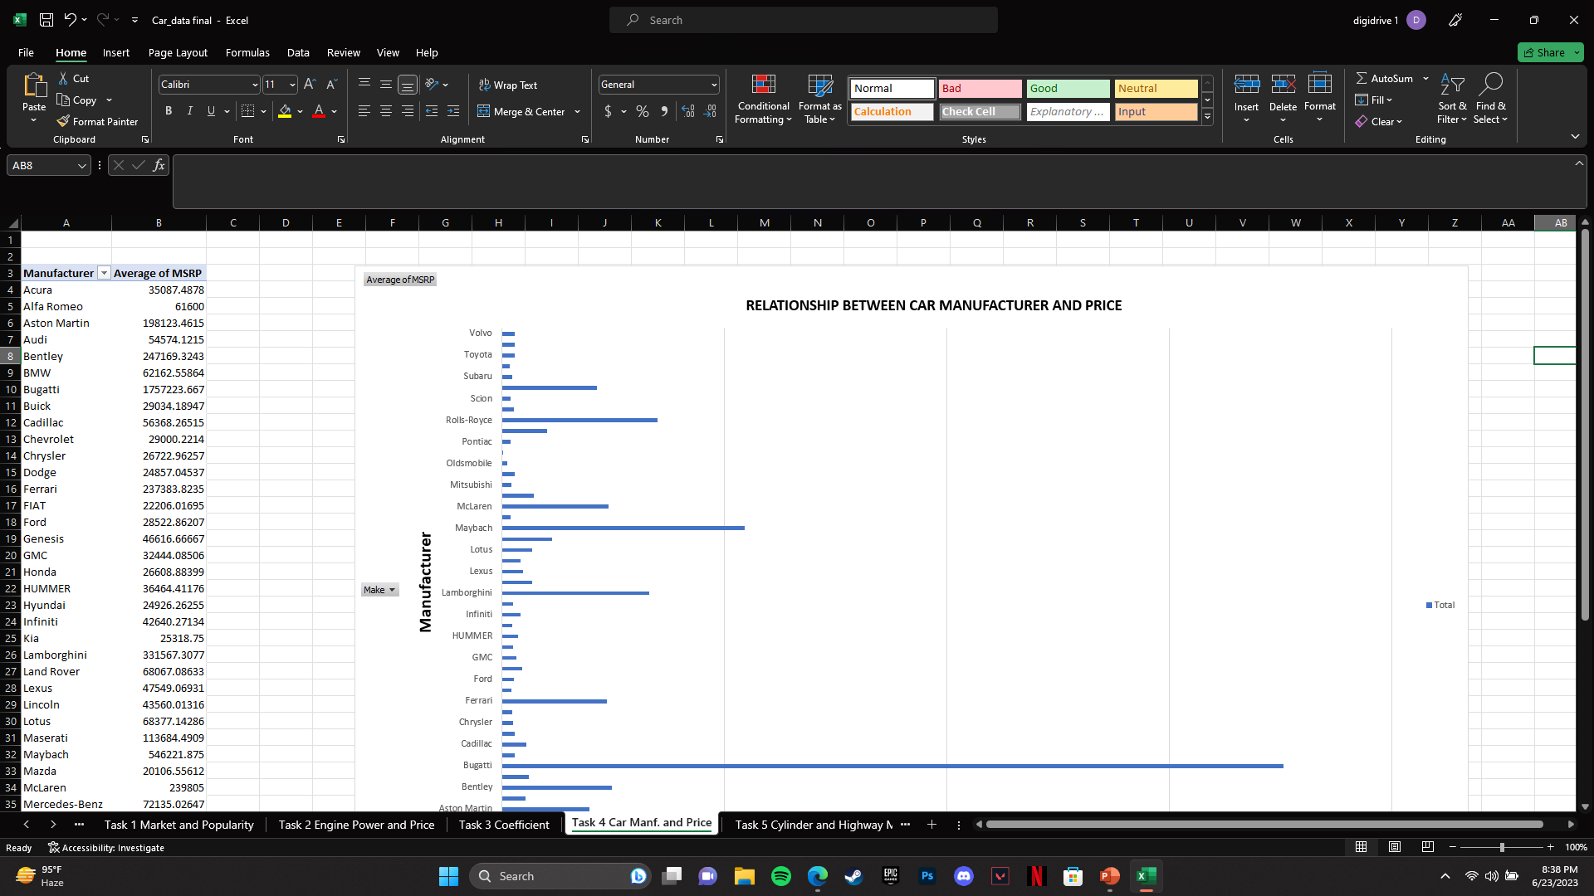
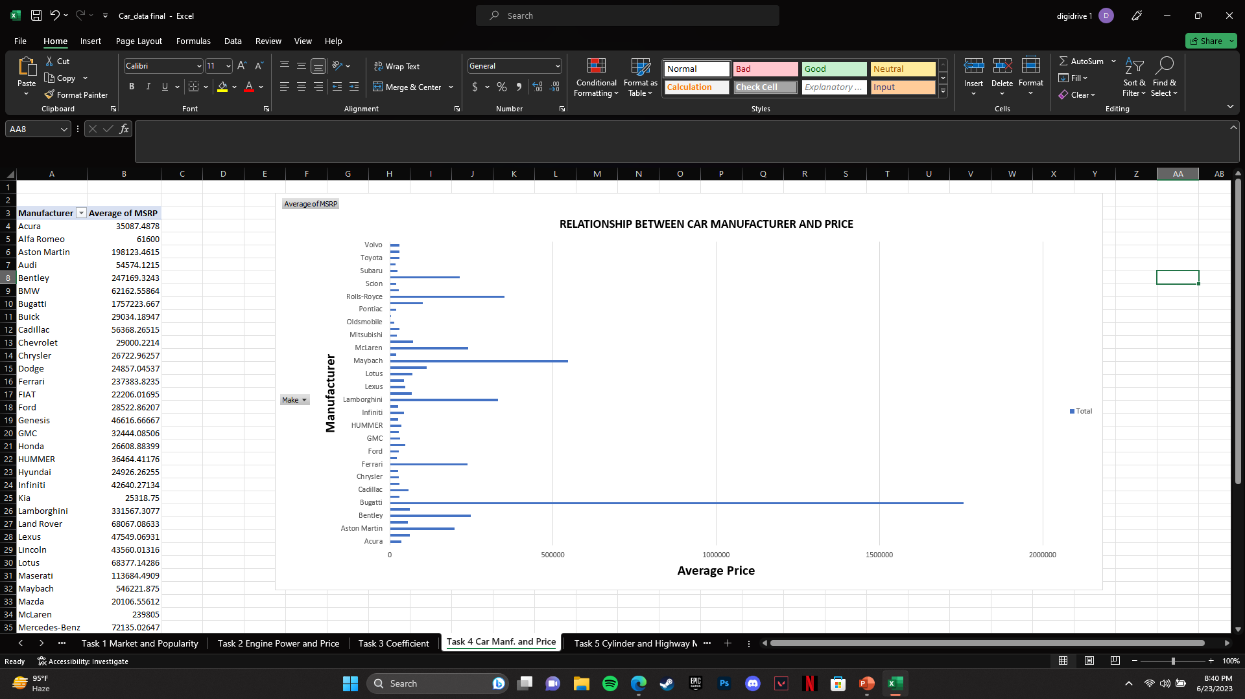
How does the average price of a car vary across different manufacturers?
Task 4.A: Create a pivot table that shows the average price of cars for each manufacturer.
Task 4.B: Create a bar chart or a horizontal stacked bar chart that visualizes the relationship between manufacturer and average price.

Slide 9
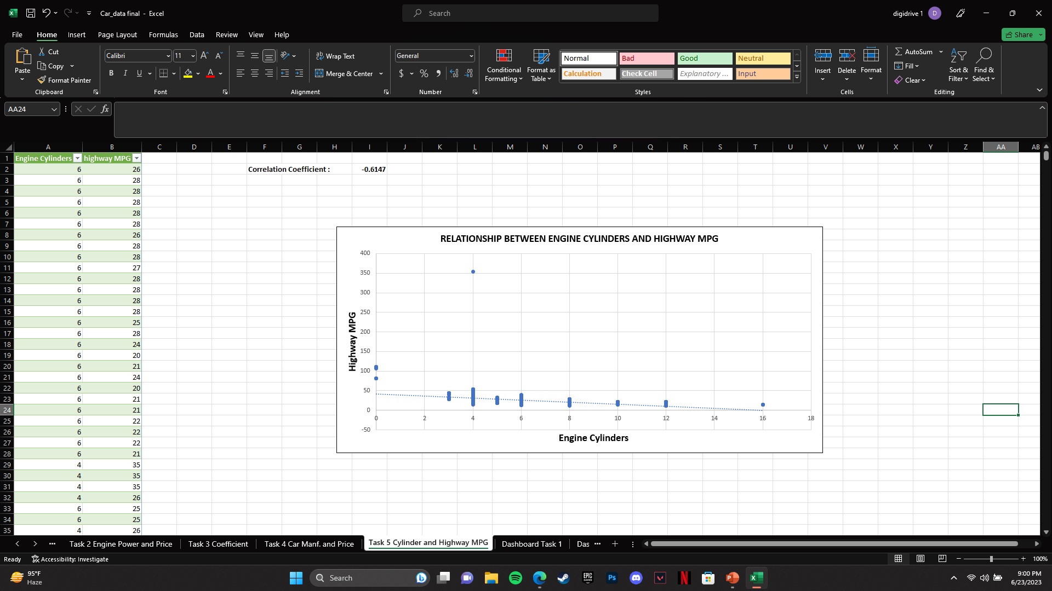

What is the relationship between fuel efficiency and the number of cylinders in a car's engine?
Task 5.A: Create a scatter plot with the number of cylinders on the x-axis and highway MPG on the y-axis. Then create a trendline on the scatter plot to visually estimate the slope of the relationship and assess its significance.
Task 5.B: Calculate the correlation coefficient between the number of cylinders and highway MPG to quantify the strength and direction of the relationship.

Slide 10
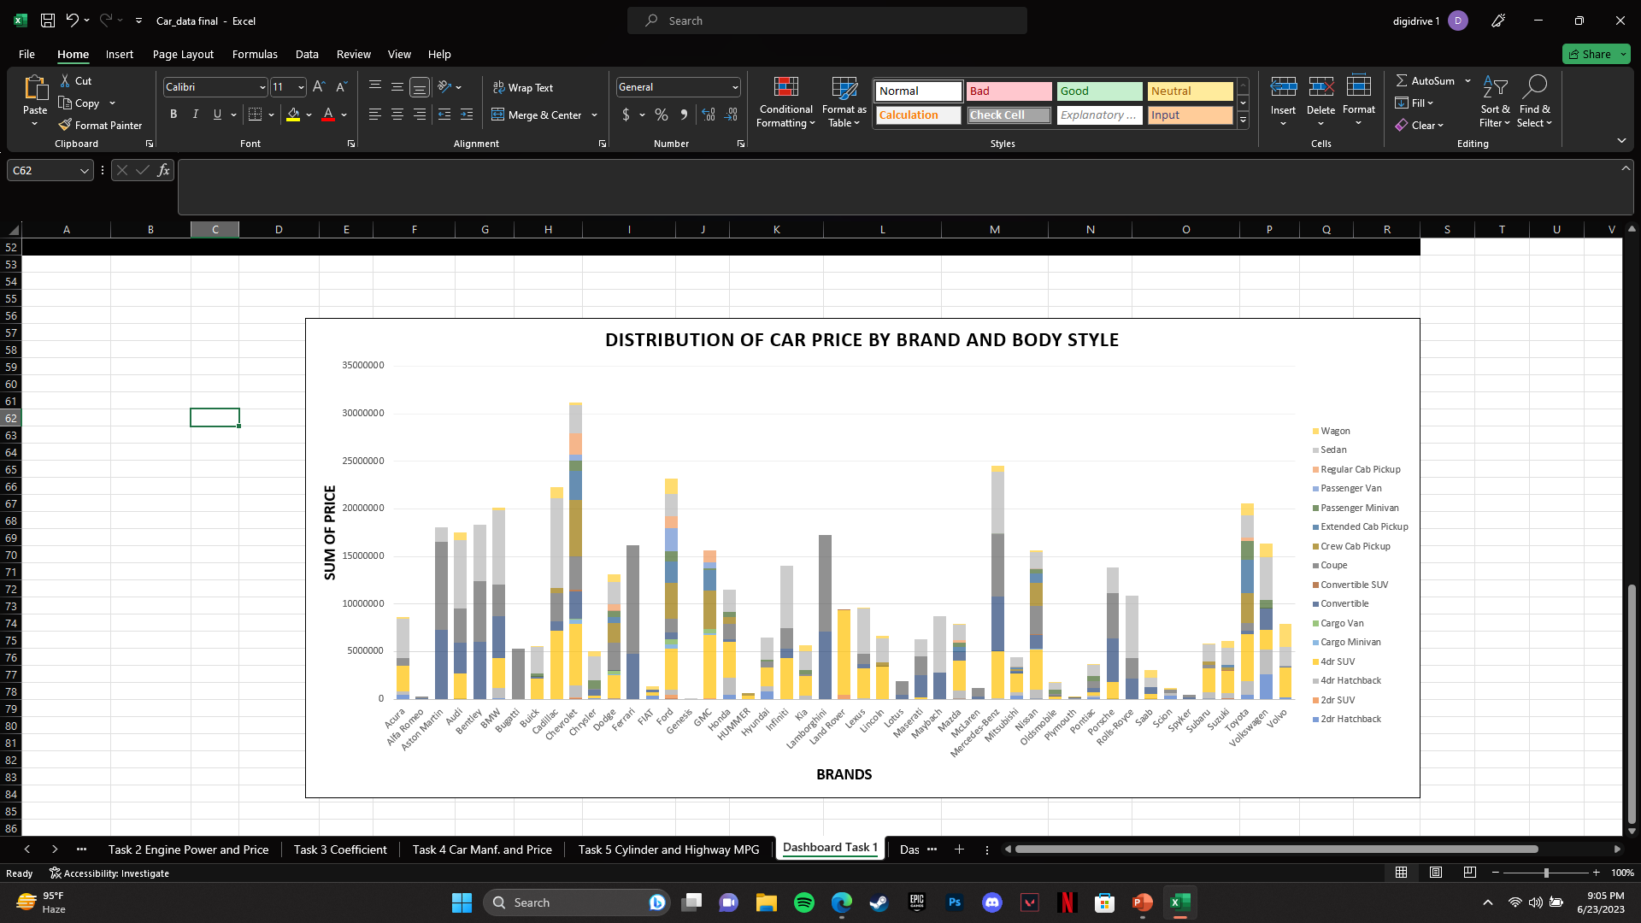
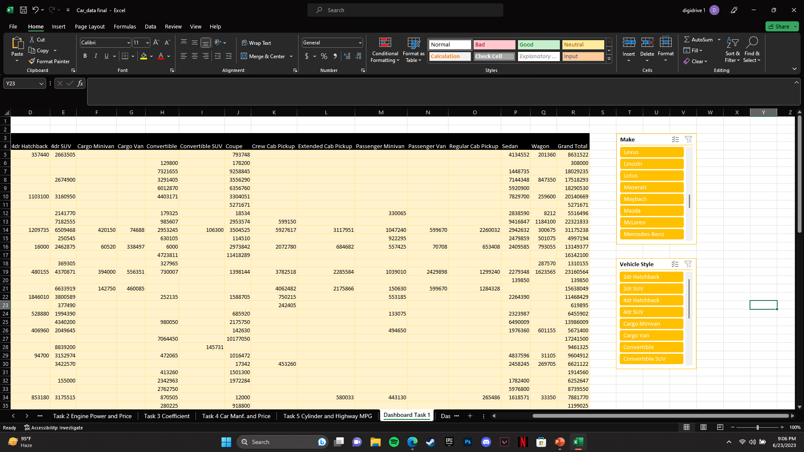
Task 1: How does the distribution of car prices vary by brand and body style?
Hints: Stacked column chart to show the distribution of car prices by brand and body style. Use filters and slicers to make the chart interactive. Calculate the total MSRP for each brand and body style using SUMIF or Pivot Tables.

Slide 11
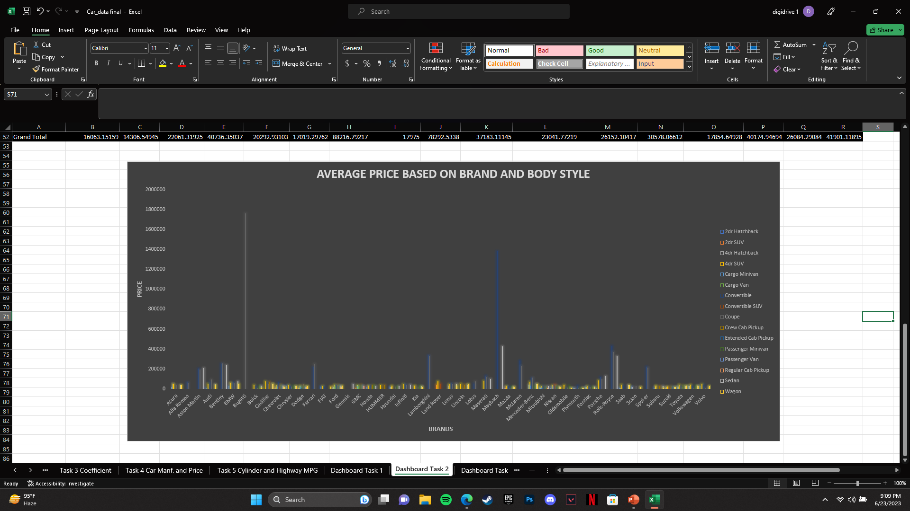
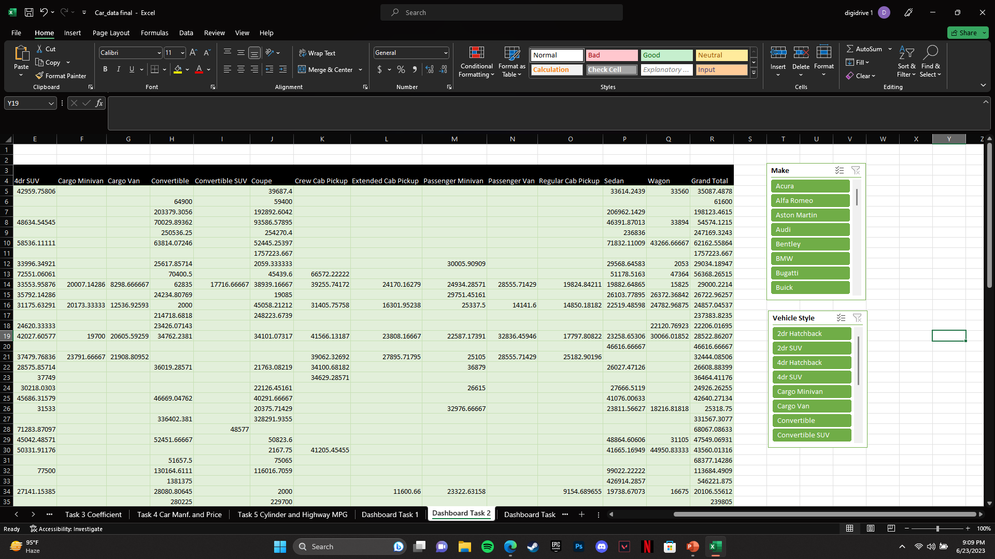
Task 2: Which car brands have the highest and lowest average MSRPs, and how does this vary by body style?
Hints: Clustered column chart to compare the average MSRPs across different car brands and body styles. Calculate the average MSRP for each brand and body style using AVERAGEIF or Pivot Tables.

Slide 12
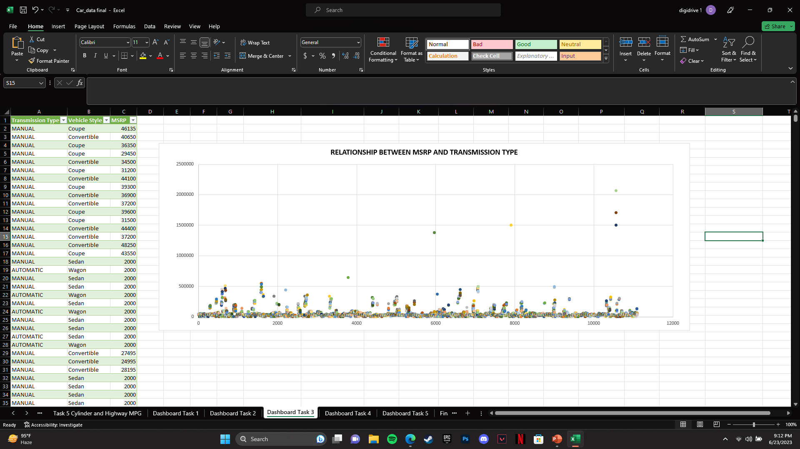
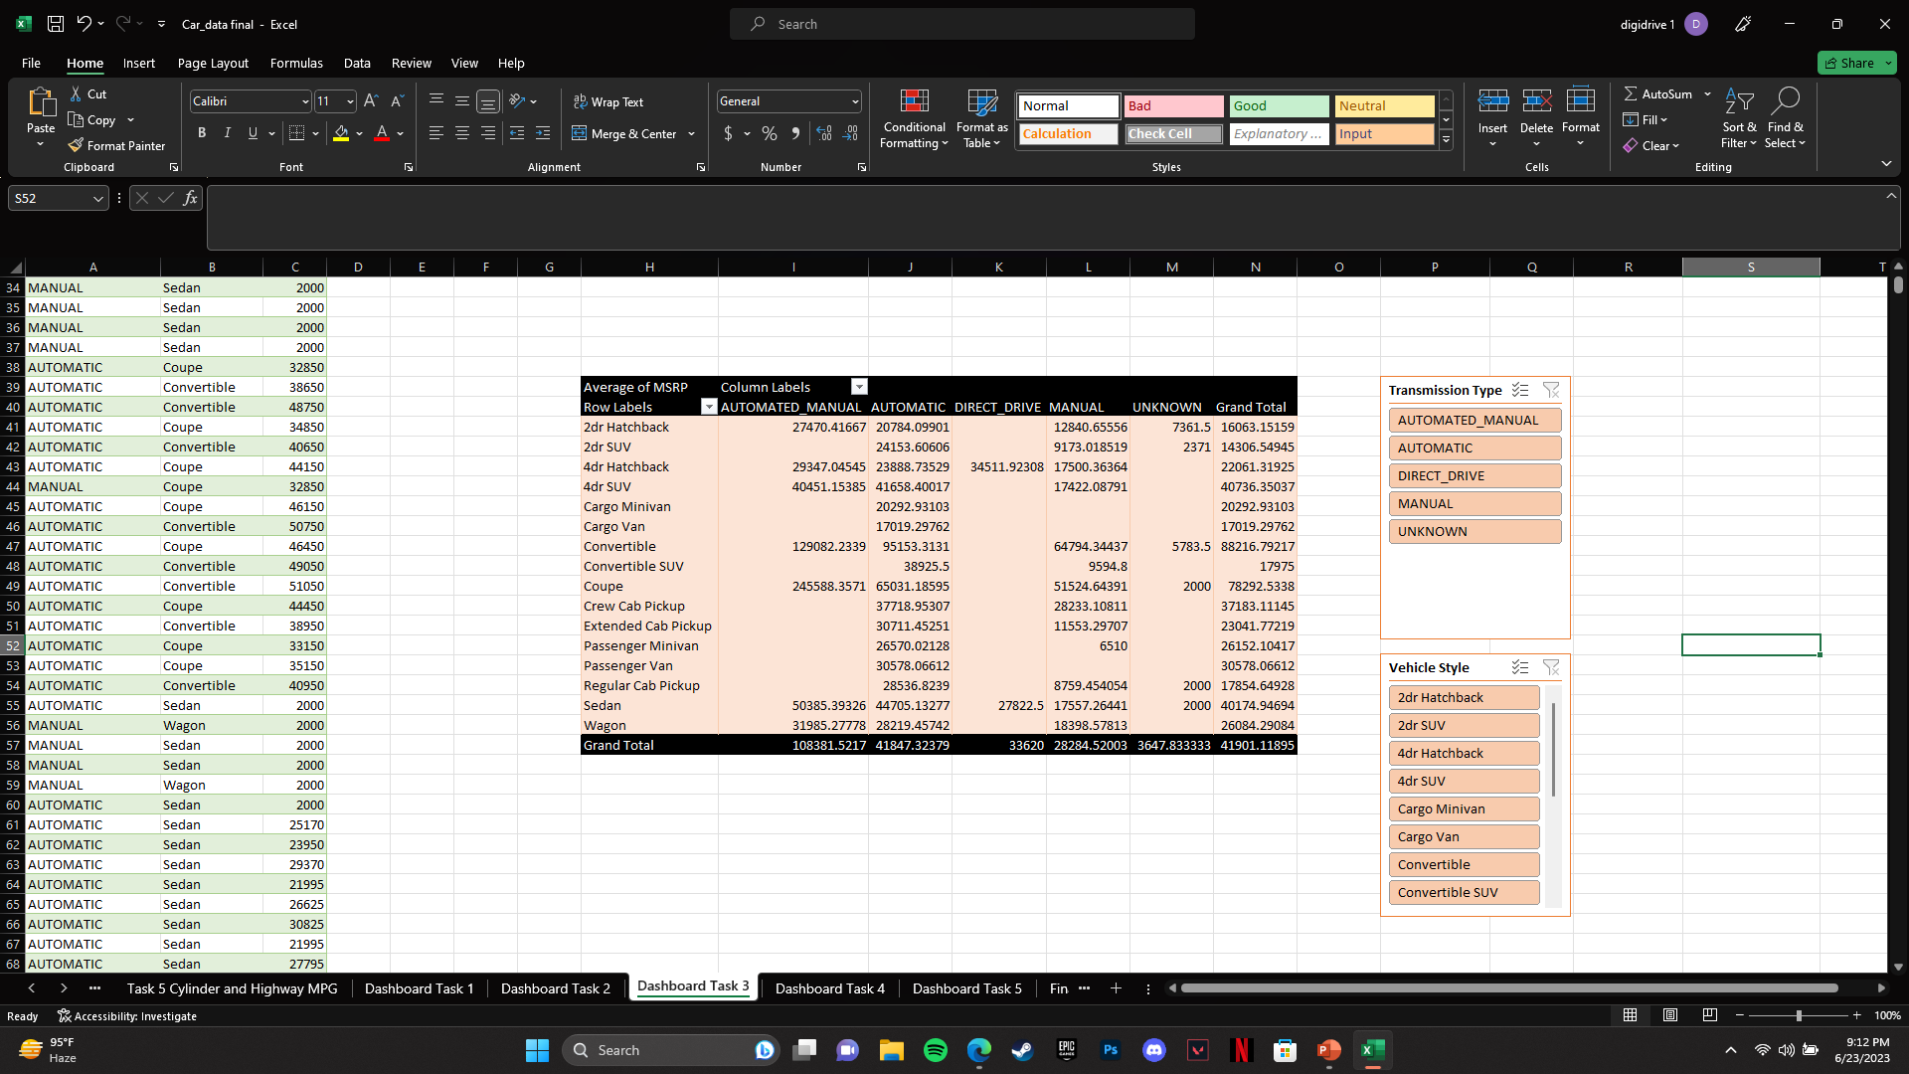
Task 3: How do the different feature such as transmission type affect the MSRP, and how does this vary by body style?
Hints: Scatter plot chart to visualize the relationship between MSRP and transmission type, with different symbols for each body style. Calculate the average MSRP for each combination of transmission type and body style using AVERAGEIFS or Pivot Tables.

Slide 13
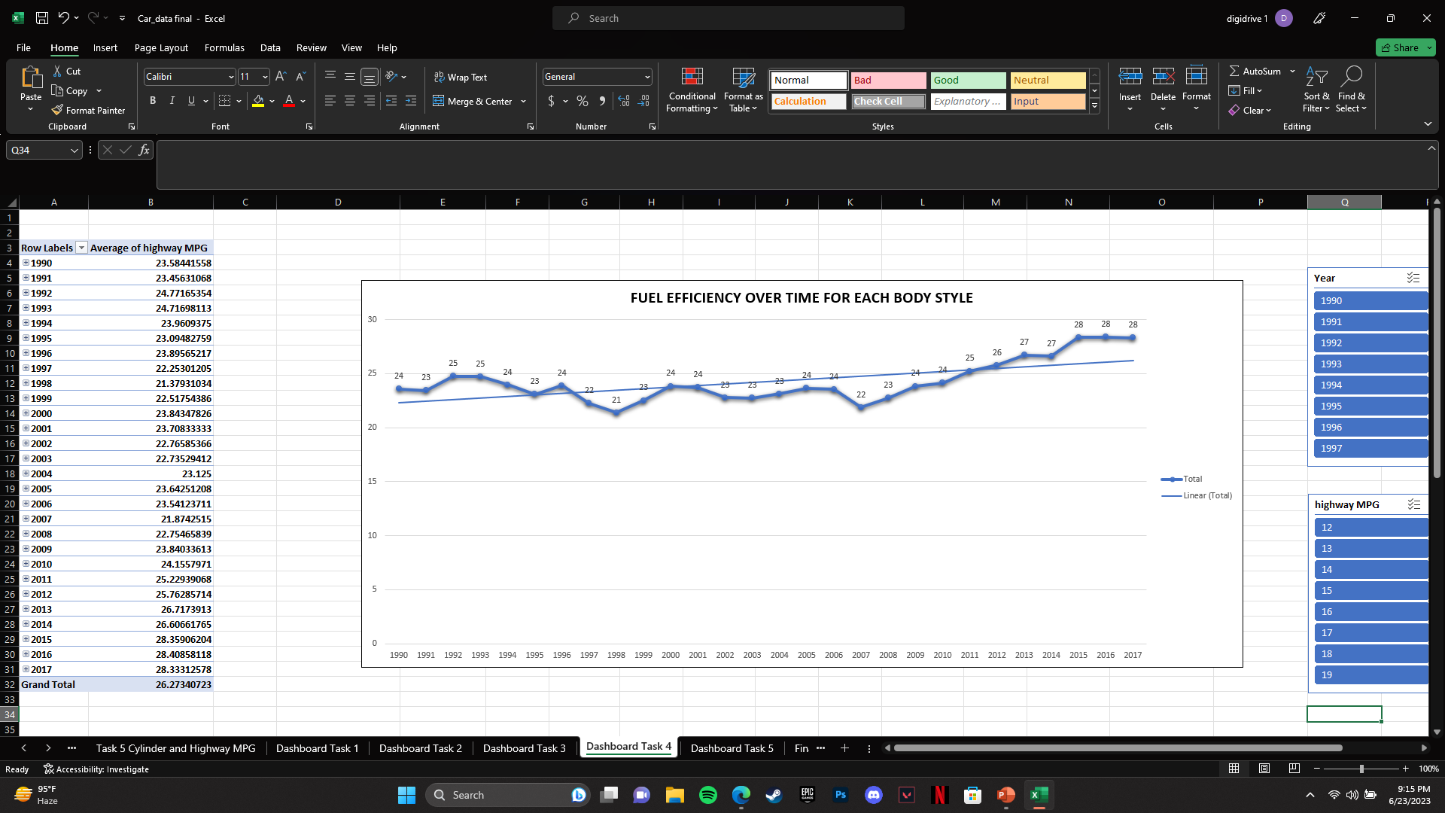
Task 4: How does the fuel efficiency of cars vary across different body styles and model years?
Hints: Line chart to show the trend of fuel efficiency (MPG) over time for each body style. Calculate the average MPG for each combination of body style and model year using AVERAGEIFS or Pivot Tables.

Slide 14
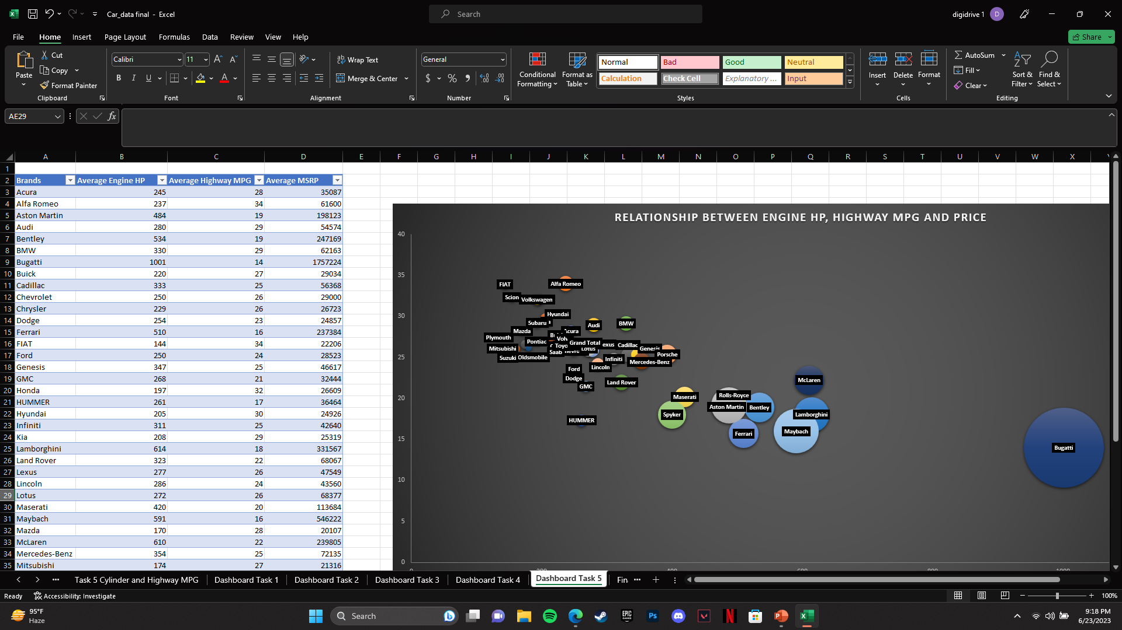
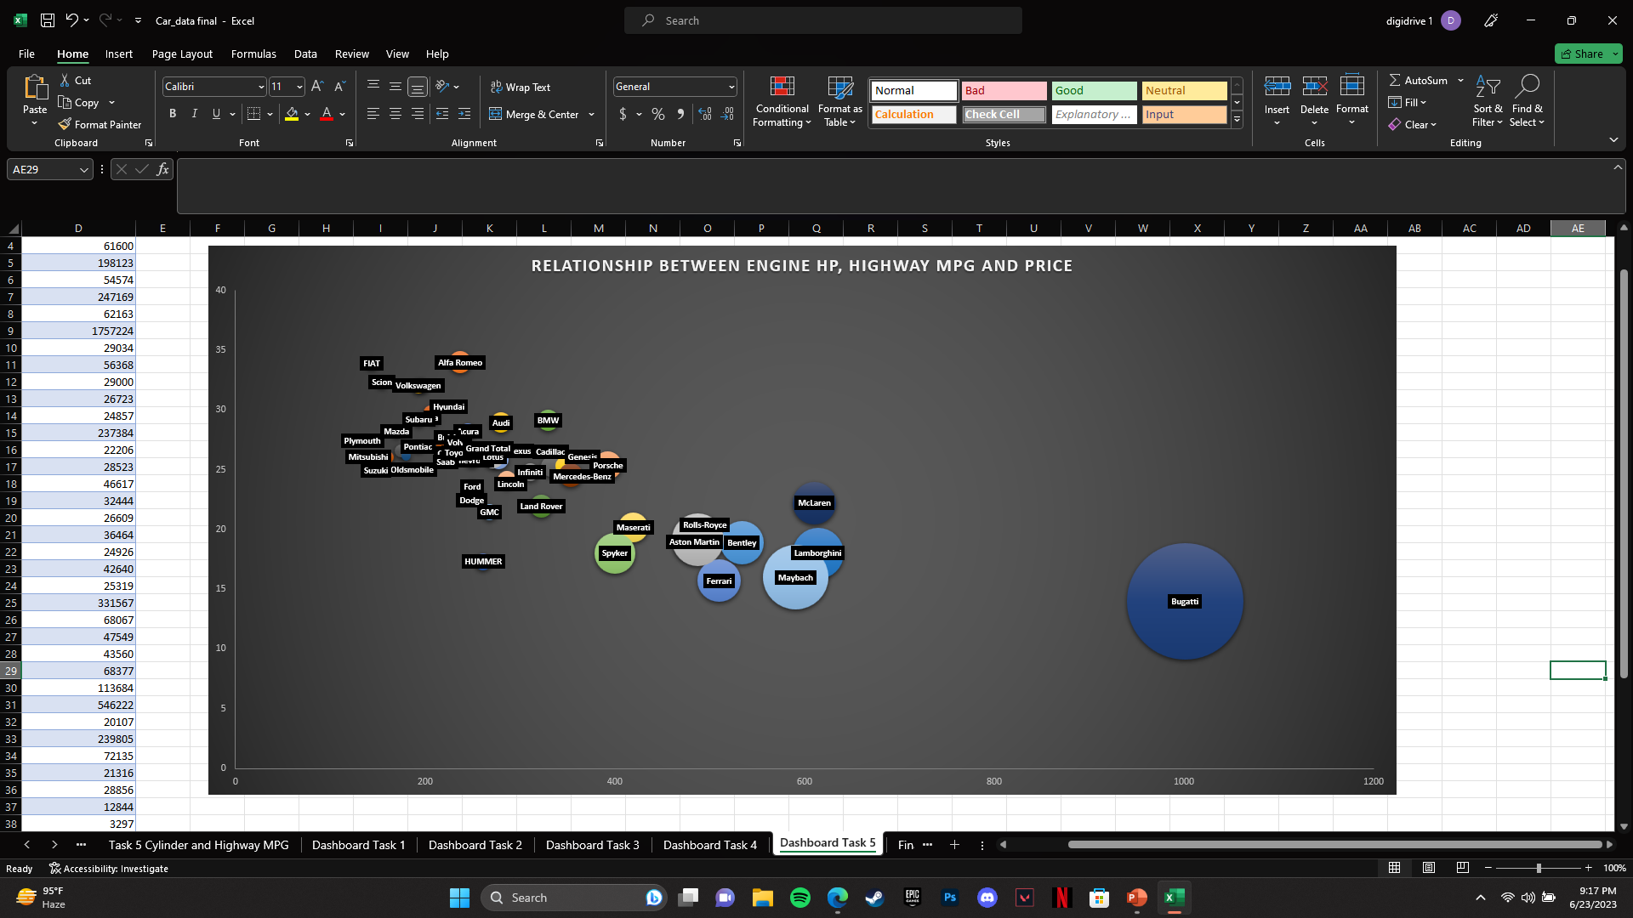
Task 5: How does the car's horsepower, MPG, and price vary across different Brands?
Hints: Bubble chart to visualize the relationship between horsepower, MPG, and price across different car brands. Assign different colors to each brand and label the bubbles with the car model name. Calculate the average horsepower, MPG, and MSRP for each car brand using AVERAGEIFS or Pivot Tables.

Slide 15
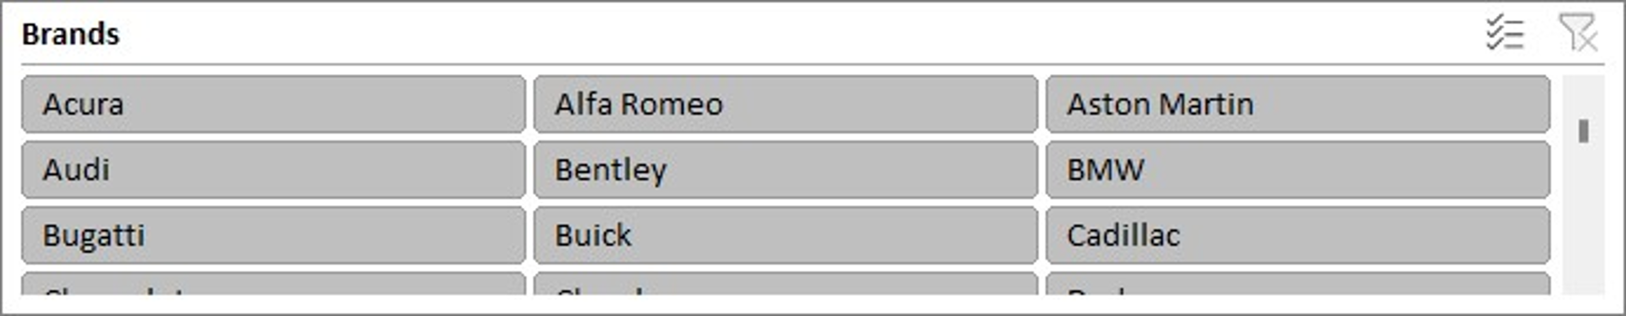
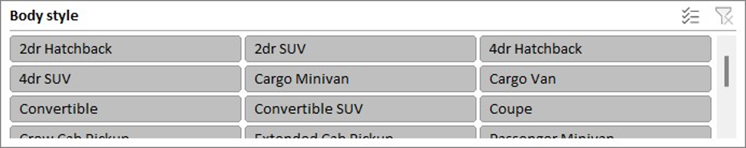
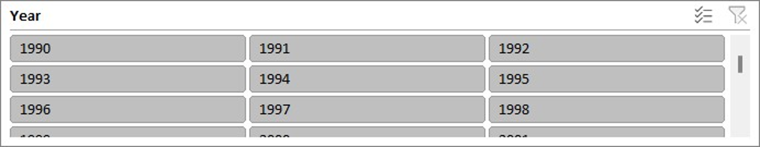
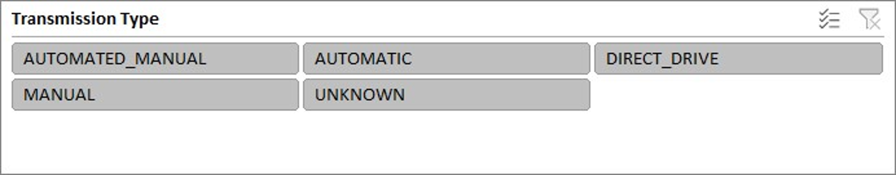
DASHBOARD

